Slide 1
Energy
Partner: Gramigna APS

Slide 2
Objectives & Goals
At the end of this module you will be able to:
To promote awareness among citizens about the importance of responsible energy consumption
To provide tools and knowledge to raise awareness about sustainable energy choices
To define key terms related to energy consumption and sustainability.
To explain the relationship between energy consumption, carbon emissions, and climate change,
and how individuals' actions contribute to global environmental issues.
To implement energy-saving practices in everyday life
To participate to local energy policies and initiatives
To design a personalized action plan for reducing energy consumption

Slide 3
Goals
At the end of this module, you will be able to:
- Understand key European policies on energy.
- Reduce personal energy impact.
- Propose individual and collective actions to mitigate energy issues.
- Evaluate urban energy management systems.
- Build a solar oven using simple materials.

Slide 4
Index
Module 1: Less energy, better future
Unit 1 - Pro-environmental management of electricity
Section 1: Evaluating the impact and energy consumption in our daily-life
Section 2: Designing energy-efficient houses
Section 3: Installing photovoltaic panels and wind turbines
Section 4. Eco-friendly appliances for home and garden furnishings
Section 5. Smart home and energy management
Section 6. Do's and Don'ts
Unit 2 - Unit 2: Pro-environmental thermal energy management
Section 1: Passive thermal efficiency
Section 2: Solar panels and heat pumps
Section 3: Pipe insulation and high-efficiency boilers
Section 4: Do's and Don'ts

Slide 5
Unit 3 - Community and local energy initiatives
Section 1: Energy communities
Section 2: Green energy providers
Section 3: Energy poverty
Section 4: How to build an energy community on a reclaimed landfill
Section 5: Do's and Don'ts
Unit 4 - Energy Management in Cities
Section 1: Introduction
Section 2: LED street lighting systems
Section 3: Central heating systems
Section 4: Low-energy urban planning
Section 5: Do's and Don'ts

Slide 6
Unit 5 - DIY: how to build a Solar kitchen
Section 1: Introduction to the Solar Oven
Section 2: Building a Solar Oven: Necessary Materials
Section 3: Construction Steps
Section 4: How to Use a Solar Oven
Section 5: Advantages of a Solar Oven
Section 6: Practical Tips and Maintenance

Slide 7
Unit 1 - Pro-environmental management of electricity
Section 1: Evaluating the impact and energy consumption in our daily-life.
Energy consumption significantly impacts the environment and sustainability, with every household contributing to global demand. Understanding individual energy use is vital for eco-friendly living. Common habits—like leaving lights on, excessive heating and cooling, and using high-energy devices—greatly affect our carbon footprint. A self-assessment of energy usage can reveal hidden waste, such as discovering that heating constitutes nearly 40% of total consumption or that standby appliances waste energy. By analysing energy bills and patterns, we can adopt better habits like turning off devices, switching to energy-efficient lighting, and lowering thermostats slightly, which can lead to substantial savings and reduced carbon emissions.

Slide 8
Unit 1 - Pro-environmental management of electricity
Several European portals help individuals assess their energy impact and promote sustainability. For instance, the European Environment Agency offers a Carbon Calculator, while the European Commission provides a tool to measure household energy habits. The Covenant of Mayors supports local initiatives to monitor energy consumption, and the European Climate Foundation offers resources for sustainable management. Additionally, tools like the Footprint calculator allow users to estimate their energy impact and suggest solutions for improvement. These resources empower individuals to make informed decisions that contribute to a more sustainable future.

Slide 9
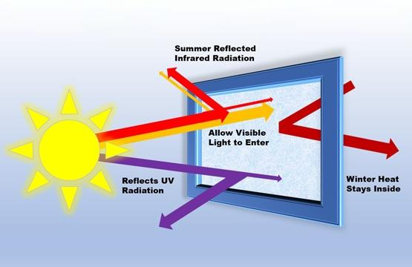
Unit 1 - Pro-environmental management of electricity
Section 2: Designing energy-efficient houses: the use of skylights and low-emissivity windows to reduce electricity consumption
In energy-efficient house design, passive methods like installing skylights and low-emissivity (low-e) windows, play a crucial role in reducing electricity consumption. Skylights allow natural sunlight to illuminate indoor spaces, minimising the need for artificial lighting during the day. This not only lowers electricity usage but also enhances the comfort of living environments. Meanwhile, low-e windows are coated with a special material that reduces heat transfer, keeping homes warm in winter and cooler in summer. By controlling heat gain and loss, these windows decrease the reliance on heating and cooling systems, further reducing energy consumption and promoting sustainability.
By incorporating skylights and Low-E windows, homeowners can significantly reduce electricity consumption and enhance overall comfort in their living spaces.

Slide 10
Unit 1 - Pro-environmental management of electricity
The following resources can help find guidelines and DIY (do it yourself) projects related to skylights and low-emissivity windows in the context of European standards and practices.
Here are some European Commission for information on designing energy-efficient houses with skylights and low-emissivity windows. The European Commission offers resources and guidelines for improving energy efficiency in buildings, including information on windows and lighting. The Passive House Institute emphasises energy-efficient building standards and practices, including the use of windows and natural light in design.

Slide 11
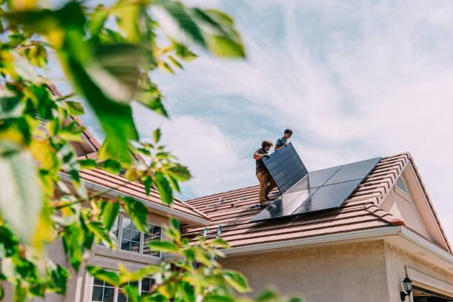
Unit 1 - Pro-environmental management of electricity
Section 3: Installing photovoltaic panels and wind turbines: how to turn a house into a clean energy micro-generator
Installing photovoltaic panels and wind turbines is an effective way to turn a house into a clean energy micro-generator. Photovoltaic panels capture solar energy and convert it into electricity, reducing dependence on fossil fuels and lowering energy bills. Wind turbines, on the other hand, harness wind power to generate energy, serving as a complementary solution, especially in areas with good wind resources. These systems not only help reduce CO2 emissions but they can also allow homeowners to sell excess energy back to the grid, creating an economic opportunity. According to the International Renewable Energy Agency (IRENA), integrating renewable sources into homes is essential for promoting the energy transition and achieving sustainability goals.

Slide 12
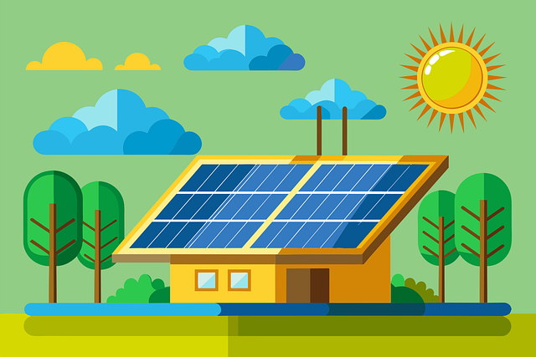
Unit 1 - Pro-environmental management of electricity
DIY construction of solar panels and small wind turbines, can be found at the following links:
Instructables: This platform features various DIY projects, including guides for building solar panels and small wind turbines.
Makezine: This site provides articles and tutorials on DIY renewable energy projects, including solar panels and wind turbines.
YouTube: Many channels offer tutorials on building solar panels
and wind turbines, providing visual guidance and practical tips.

Slide 13
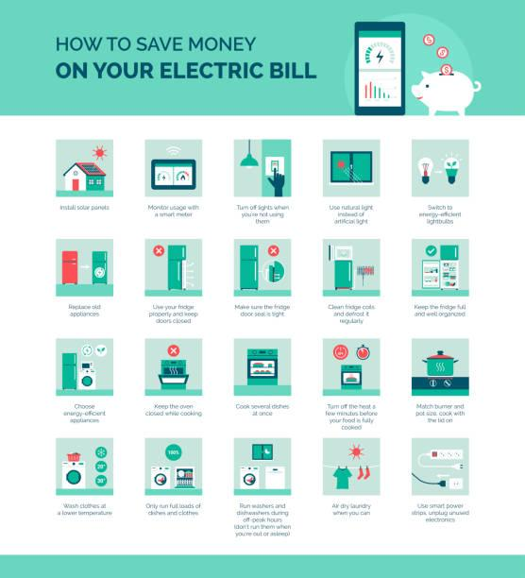
Unit 1 - Pro-environmental management of electricity
Eco-friendly appliances for home and garden furnishings
Choosing eco-friendly appliances is essential for reducing energy consumption and minimising environmental impact. By selecting energy-efficient products and adopting mindful usage habits, households can significantly lower their energy bills while contributing to a more sustainable future.
1. Look for the EU Energy Label when purchasing appliances to ensure you choose energy-efficient models.
2. Follow the guidelines from the European Environment Agency on using appliances efficiently, such as running full loads in washing machines and dishwashers.
3. Consult the Energy Saving Trust for tips on optimising appliance use and maintaining them to ensure maximum efficiency.

Slide 14
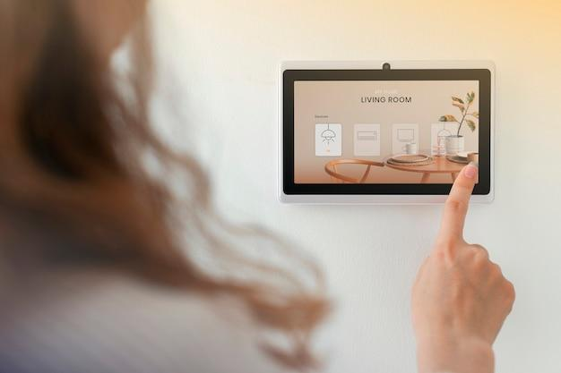
Unit 1 - Pro-environmental management of electricity
Section 5. Smart home and energy management: technologies and tips to reduce electricity consumption in daily life
The rise of smart home technology offers innovative solutions for managing energy consumption and enhancing efficiency in daily life. By integrating devices such as smart thermostats, energy monitors, and automated lighting systems, homeowners can significantly reduce electricity usage while maintaining comfort and convenience. Implementing these technologies not only lowers energy bills but also contributes to a more sustainable future.
To effectively manage energy consumption in a smart home, consider the following technologies and tips:
1. Smart Thermostats
2. Energy Monitoring Systems
3. Smart Lighting
4. Smart Plugs
5. Home Automation Systems
6. Energy-Efficient Appliances
7. Regular Maintenance
8. Educate Household Members

Slide 15
Unit 1 - Pro-environmental management of electricity
1. Smart Thermostats: install a smart thermostat to optimise heating and cooling. These devices learn your schedule and preferences, adjusting temperatures automatically to save energy when you're away.
2. Energy Monitoring Systems: use smart energy monitors to track real-time electricity usage. These devices provide insights into which appliances consume the most energy, helping you make informed decisions.
3. Smart Lighting: switch to LED smart bulbs that can be controlled remotely. Use timers or motion sensors to ensure lights turn off when not needed, reducing wasted energy.
4. Smart Plugs: utilise smart plugs for appliances. These can be programmed to turn off devices during peak hours or when not in use, preventing phantom energy drain.
5. Home Automation Systems: integrate various smart devices through a centralised hub, allowing you to automate tasks, such as dimming lights or adjusting the thermostat based on occupancy.
6. Energy-Efficient Appliances: invest in energy-efficient appliances with high Energy Star ratings. These consume less electricity while providing the same functionality.
7. Regular Maintenance: keep appliances well-maintained to ensure optimal performance. Clean filters, check seals, and perform necessary repairs to prevent energy loss.
8. Educate Household Members: encourage everyone in the household to adopt energy-saving habits, such as turning off lights when leaving a room and unplugging devices not in use.
By leveraging smart technologies and cultivating mindful habits, it is possible to significantly reduce electricity consumption and
enhance home’s energy efficiency.

Slide 16
Unit 1 - Pro-environmental management of electricity
Section 6. Do’s and don’ts
1. Educate Household Members: encourage everyone to adopt energy-saving habits and be mindful of electricity use.
2. Use Smart Thermostats: install smart thermostats to optimise heating and cooling based on occupancy and preferences.
3. Implement Energy Monitoring: use energy monitors to track usage patterns and identify high-consumption appliances.
4. Utilise Natural Light: maximise daylight by opening curtains and using skylights to reduce reliance on artificial lighting.
5. Consider Solar Power: install solar panels to harness renewable energy and reduce dependence on the grid.
1. Don't overuse heating or cooling: refrain from setting thermostats to extreme temperatures; use moderate settings instead.
2. Don't leave devices on standby: avoid leaving electronics plugged in when not in use; unplug them to prevent phantom energy drain.
3. Don't use old, inefficient appliances: avoid keeping outdated appliances that consume excessive energy; consider upgrading to more efficient models.
4. Don't overestimate energy needs: refrain from using more energy than necessary; be mindful of your consumption
habits.

Slide 17
Unit 2: Pro-environmental thermal energy management
Section 1: Passive thermal efficiency: how double-glazed windows and insulation can reduce energy demand.
Passive thermal efficiency is achieved by optimising a building’s ability to maintain comfortable indoor temperatures without relying heavily on active heating or cooling systems. Key components include double-glazed windows and effective insulation.
How It Works:
Double-Glazed Windows: these windows consist of two panes of glass with a layer of air or gas (like argon) between them. This design significantly reduces heat transfer, keeping homes warm in winter and cooler in summer. By
minimising heat loss, double-glazed windows can lead to substantial energy savings.
Insulation: proper insulation in walls, roofs, and floors prevents heat from
escaping in winter and entering in summer. Materials like fibreglass, foam, and cellulose
are commonly used. High-quality insulation can maintain indoor temperatures, reducing
the need for heating and cooling systems to work as hard.

Slide 18
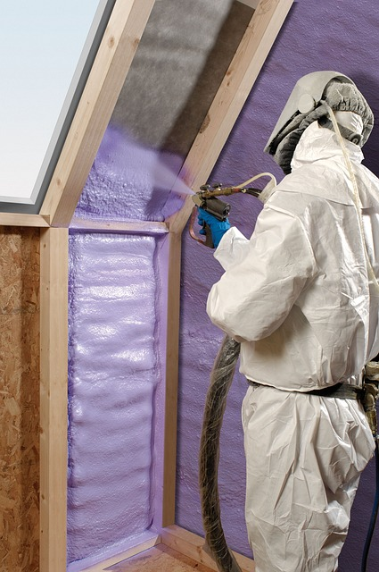
Unit 2: Pro-environmental thermal energy management
There are also the DIY techniques related to this topic:
1. window insulating films: apply adhesive films to windows to reduce heat loss. Here you can find a DIY very cheap and easy to create
2. thermal curtains: it’s possible to create heavy or lined curtains using insulating materials. For tips on making your own, is possible to see this article.
3. sealing gaps: Identifying and sealing cracks or gaps around windows and doors with foam insulation or silicone helps prevent drafts. Learn more about sealing gaps.
4. Insulating wall coverings: use rigid insulation panels, such as polystyrene, helps to improve the insulation of internal walls. For guidance, visit this.
5. green roof: if there's access to a flat roof, consider creating a green roof. A cheap solution for better house insulation.

Slide 19
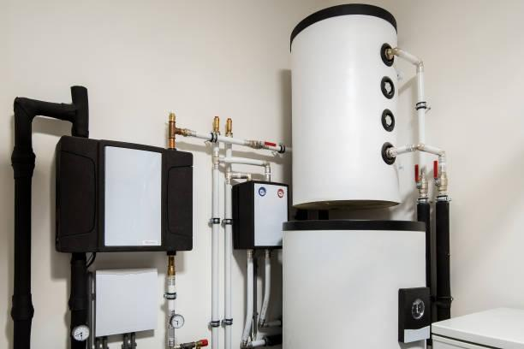
Unit 2: Pro-environmental thermal energy management
Section 2: Solar panels and heat pumps: active technologies for sustainable home heating
Solar panels and heat pumps are pivotal active technologies for sustainable home heating.
Solar panels and heat pumps can provide significant energy savings for households.
Solar Panels: by generating their own electricity, homes can reduce or even eliminate their electricity bills. Depending on the size of the system and local solar irradiance, homeowners can save anywhere from 50% to 100% on their energy costs. In some cases, excess energy can be sold back to the grid, further increasing savings.
Heat Pumps: these systems are highly efficient, often providing three to four units of heat for every unit of electricity consumed. This means they can reduce heating costs by 30% to 60% compared to traditional heating systems like gas or electric furnaces.
Overall, combining both technologies can lead to substantial annual savings on energy bills, while also contributing to reduced greenhouse gas emissions and a lower environmental impact.

Slide 20
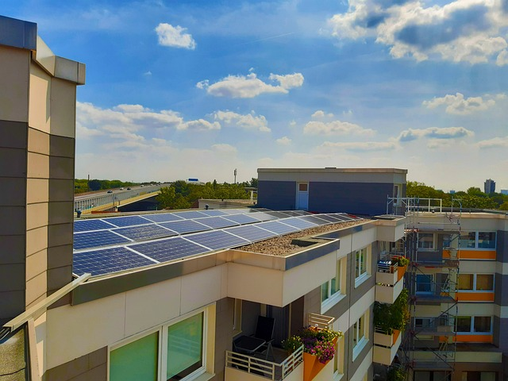
Unit 2: Pro-environmental thermal energy management
0
Solar panels convert sunlight into electricity, which can power heating systems or be stored for later use, significantly reducing reliance on fossil fuels. Heat pumps, on the other hand, extract heat from the air or ground and transfer it into the home, offering an efficient alternative to traditional heating methods. Together, these technologies can drastically lower energy bills and carbon footprints. For DIY enthusiasts, there are several projects to explore, such as building a solar water heater or installing a heat pump system. Resources like the European Solar Thermal Industry Federation provide useful insights, while websites like Instructables feature DIY guides on solar heaters and heat pump installations.

Slide 21
Unit 2: Pro-environmental thermal energy management
Section 3: Pipe insulation and high-efficiency boilers: practices to reduce heat waste
Pipe insulation and high-efficiency boilers are essential practices for reducing heat waste in homes. Properly insulating pipes can prevent heat loss as hot water travels through the system, ensuring that more energy is used for heating rather than wasted. High-efficiency boilers, designed to maximise energy output while minimising fuel consumption, can also reduce heating costs significantly. These boilers often achieve efficiency ratings of 90% or higher. For those interested in DIY projects, resources like the Energy Saving Trust provide guidance on insulating pipes effectively, while Instructables offers various projects related to boiler efficiency improvements. Additionally, the European Heating Industry promotes high-efficiency heating solutions that can further aid in reducing heat waste.
Going deeper, pipe insulation and high-efficiency boilers can yield significant energy savings:

Slide 22
Unit 2: Pro-environmental thermal energy management
1. Pipe Insulation: properly insulating hot water pipes can reduce heat loss by 5% to 10%. This means less energy is required to maintain water temperature, leading to lower heating bills. For homes with extensive plumbing, the savings can be even more substantial.
2. High-Efficiency Boilers: these boilers can operate at efficiency rates of 90% or higher, compared to traditional boilers that often operate at around 70- 80%. This improved efficiency can lead to a reduction in energy consumption by 15% to 30%, translating to significant savings on heating costs.
Together, these practices can result in overall energy savings of 20% to 30% for heating systems, contributing to lower utility bills and a reduced carbon footprint.

Slide 23
Unit 2: Pro-environmental thermal energy management
Do’s and don’ts
Insulation Improvement: upgrade insulation in buildings to minimise heat loss.
Energy-Efficient Equipment: replace old heating systems with high-efficiency models (e.g., heat pumps).
Solar Thermal Systems: install solar collectors for heating water or air.
Using Outdated Technology: don’t invest in old, inefficient heating systems; prioritise modern, energy-efficient solutions.
Compromising Insulation: avoid skimping on insulation; inadequate insulation leads to significant energy waste.
Prioritising Cost Over Sustainability: don’t focus solely on initial costs; consider long-term savings and environmental benefits.

Slide 24
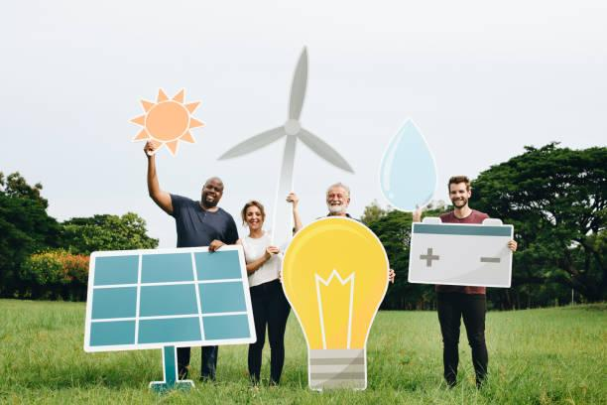
Unit 3 - Community and local energy initiatives
Section 1: Energy communities: energy sharing models for a sustainable future
An energy community is a collaborative initiative where individuals, businesses, and organisations come together to produce, consume, and manage energy collectively. These communities typically focus on renewable energy sources, aiming to enhance energy independence, sustainability, and efficiency.
Energy communities can emerge through various pathways, including grassroots initiatives, local government support, and partnerships with energy cooperatives. The process often involves engaging stakeholders to assess energy needs, develop a shared vision, and implement renewable energy projects, such as solar panels or wind turbines.
The European Union has established several regulations to promote energy communities, notably the Clean Energy for All Europeans package, which includes the Directive (EU) 2018/2001 on the promotion of the use of energy from renewable sources and the Directive (EU) 2019/944 on common rules for the internal market for electricity. These directives emphasise the importance of citizen participation in energy production and the legal recognition of energy communities.

Slide 25
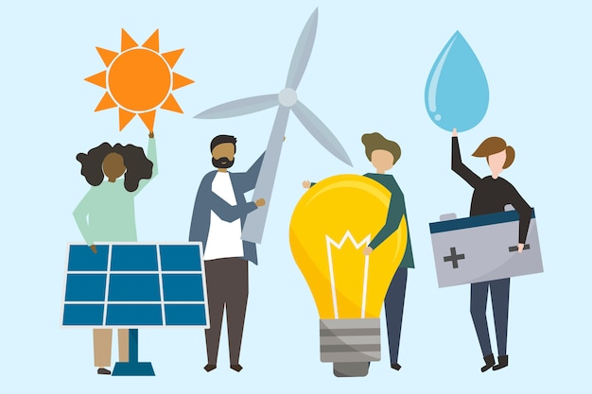
Unit 3 - Community and local energy initiatives
There are Environmental, Social, and Political Benefits
1. Environmental Benefits: energy communities contribute to reducing greenhouse gas emissions by promoting the use of renewable energy, thereby decreasing reliance on fossil fuels.
2. Social Benefits: they foster local engagement, strengthen community ties, and enhance energy resilience. Members can benefit from lower energy costs and increased energy security.
3. Political Benefits: energy communities empower citizens by giving them a voice in energy decisions, promoting democratic participation in energy governance, and aligning with EU goals for a sustainable energy transition.
In summary, energy communities represent a transformative approach to energy management, promoting environmental sustainability, social cohesion, and political empowerment within local contexts.

Slide 26
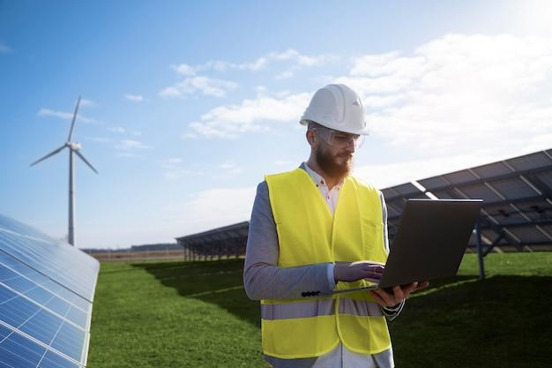
Unit 3 - Community and local energy initiatives
Section 2: Green energy providers: how to choose who powers your home with renewable energy
Choosing a green energy provider for home involves several factors to ensure the selection of a company that aligns with personal sustainability goals. There’s some point to consider to make an informed decision.
How to choose a green energy provider:
1. check certification: look for certifications that confirm the provider's renewable energy sources.
2. understand energy sources: investigate the types of renewable energy the provider uses.
3. evaluate transparency: choose a provider that is transparent about their energy sourcing and pricing.
4. compare pricing: compare rates and assess overall value.
5. customer reviews: read testimonials to gauge reliability and customer service quality.
6. local impact: consider providers that invest in local renewable projects.
7. contract terms: review the terms of service, including cancellation policies.

Slide 27
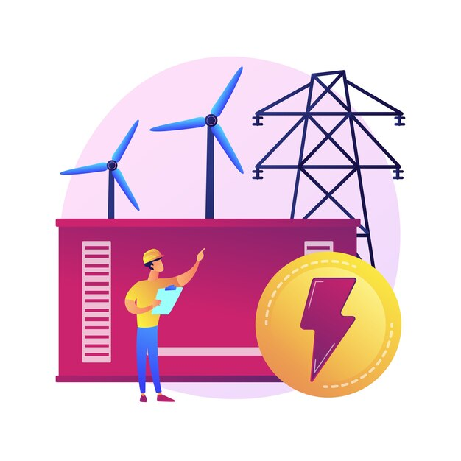
Unit 3 - Community and local energy initiatives
After this it is possible to find green energy providers in all Europe. Going deeper in the countries involved in this project, here is possible to find some notable provider:
1. E’nostra (Italy): a cooperative focused on renewable energy and sustainability.
2. Tauron (Poland): provides renewable energy solutions with a commitment to local projects.
3. Energia (Portugal): offers 100% renewable energy and promotes energy efficiency.
4. Holaluz (Spain): specializes in renewable energy sourcing and supports local projects.
5. EPH (Czech Republic): a provider focusing on sustainable energy sources.
With hese guidelines and exploring the listed providers, it is possible to make a more informed decision when selecting a green energy provider for home.

Slide 28
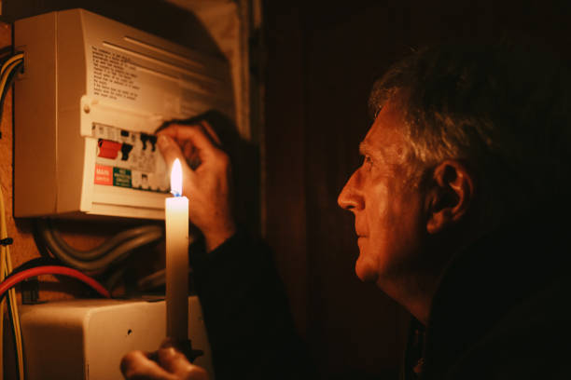
Unit 3 - Community and local energy initiatives
Section 3: Energy poverty: community strategies to ensure equitable access to sustainable energy
Energy poverty affects vulnerable populations by limiting their access to affordable and sustainable energy sources. Community strategies to combat this issue include establishing local energy cooperatives, implementing energy efficiency programs, and leveraging renewable energy projects. These initiatives can help create inclusive energy systems that empower marginalised groups. For example, community solar projects allow residents to share the benefits of renewable energy, reducing costs and increasing access. Additionally, partnerships with local governments and NGOs can enhance support for energy-saving measures and financial assistance programs.
For further reading, you can explore:
1. International Energy Agency (IEA): Energy Poverty
2. European Commission: Energy Poverty
3. REN21: Renewable Energy and Energy Poverty

Slide 29
Unit 3 - Community and local energy initiatives
Section 4: How to build an energy community on a reclaimed landfill: the project by partner Gramigna in Italy
The project aims to evaluate the feasibility of constructing a ground-based photovoltaic (PV) plant in the municipality of Torrecuso (Italy), locate it where there was a landfill site, now reclaimed, as that area cannot have any productive use. The study assesses the environmental, territorial, and energy-related aspects of the proposed plant, focusing on urban planning, territorial constraints, and potential natural hazards that could impact the construction. Additionally, the study examines the site's energy production potential and its connection to the local electricity grid.
The analysis includes considerations such as the Regional Landscape Plan, the Hydrogeological Structure Plan (PAI), and other regional and national regulations. The proposed site, located in an agricultural area, is exposed to south-east, which is favourable for energy production. It covers approximately 32,165 square metres of land classified as agricultural and forested areas.
The planned PV plant will have an installed capacity of 409.6 kW, expected to generate 495 MWh annually. Several factors, including local shading, temperature losses, and system inefficiencies, are accounted for in the production estimates. The installation will consist of 1,024 solar panels mounted on steel supports, with a tilt angle of 10° to minimise shading and wind load effects.

Slide 30
Unit 3 - Community and local energy initiatives
The project's authorization process is subject to regional landscape constraints, especially due to the location within the Taburno Natural Park. The plant's connection to the electrical grid is feasible, with the site located near a medium-voltage line.
In conclusion, while the project is viable from an energy production perspective, its implementation is contingent upon overcoming significant environmental and regulatory hurdles.
Here is possible to read the business plan of this rural energy community

Slide 31
Unit 3 - Community and local energy initiatives
Do’s and don’ts
1. explore funding options: research grants, subsidies, and crowdfunding to support projects.
2. promote education and awareness: organise workshops to inform the community about renewable energy benefits.
3. search energy providers that use green energies.
4. search for local innovative solution for the community
5. build partnerships: collaborate with local NGOs, universities, and businesses for support and expertise.
1. ignore community input: avoid making decisions without consulting the community; it can lead to resistance.
2. underestimate costs: don’t overlook hidden costs; budget comprehensively to avoid financial shortfalls.

Slide 32
Unit 4 - Energy Management in Cities
Section 1: introduction
The three most important areas of focus in energy management in cities are:
1. Energy Efficiency: Implementing strategies to reduce energy consumption in buildings and infrastructure is crucial. This includes retrofitting existing structures, promoting energy-efficient appliances, and utilising smart technologies like building management systems to optimise energy use.
2. Renewable Energy Integration: Cities need to incorporate renewable energy sources, such as solar, wind, and geothermal, into their energy mix. This involves creating incentives for renewable installations, developing community solar projects, and ensuring grid infrastructure can support distributed energy generation.
3. Sustainable Transportation: Promoting public transport, cycling, and electric vehicles is essential for reducing urban energy consumption and emissions. Cities can implement policies that encourage sustainable transportation options, such as expanding public transit networks, developing cycling infrastructure, and incentivizing electric vehicle use through charging stations.
Focusing on these areas can help cities achieve more sustainable energy management and reduce their environmental impact.
In this unit we will deal with specific actions, as the field of analysis is too large.

Slide 33
Unit 4 - Energy Management in Cities
Section 2: LED street lighting systems: how cities are reducing energy consumption and improving safety
LED street lighting systems are transforming urban environments by significantly reducing energy consumption and
enhancing safety. Cities adopting LED technology can achieve up to 50-70% energy savings compared to traditional streetlights, while also reducing maintenance costs due to the longer lifespan of LEDs. Best practices include:
1. smart lighting controls: implementing adaptive lighting systems that adjust brightness based on real-time traffic and pedestrian activity, such as in Los Angeles, which has reduced energy use and improved safety. More information can be found here.
2. community engagement: involving local residents in the planning process, as seen in Amsterdam, where feedback helped design a more effective lighting strategy that enhances safety. You can find specific information about their street lighting project in Amsterdam Smart City
3. integrated infrastructure: combining street lighting with smart city technology, like in Barcelona, where streetlights are equipped with sensors to monitor air quality and traffic.
These practices not only improve energy efficiency but also contribute to safer and more vibrant urban spaces.

Slide 34
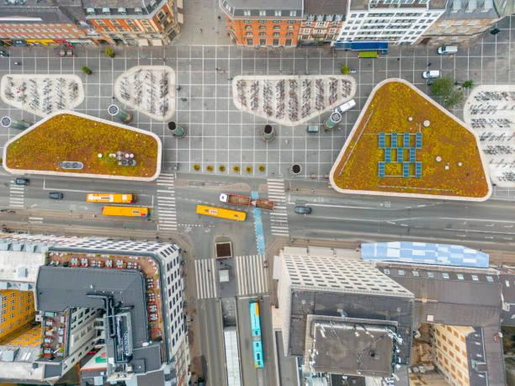
Unit 4 - Energy Management in Cities
Section 3: Central heating systems: sustainable solutions for urban areas
Central heating systems play a crucial role in urban areas, especially for ensuring comfort and energy efficiency. Sustainable solutions are increasingly essential as cities strive to reduce carbon footprints and promote renewable energy. One effective approach is the implementation of district heating systems, which utilise waste heat from power plants or industrial processes. For instance, Copenhagen's district heating network draws heat from waste incineration and geothermal sources, serving over 97% of the city's homes while achieving significant carbon reductions.
Another best practice is the integration of renewable energy sources into heating systems. In Helsinki, a hybrid heating system combines biomass, waste heat, and solar thermal energy, creating a resilient and sustainable infrastructure. This approach not only decreases reliance on fossil fuels but also enhances energy security.

Slide 35
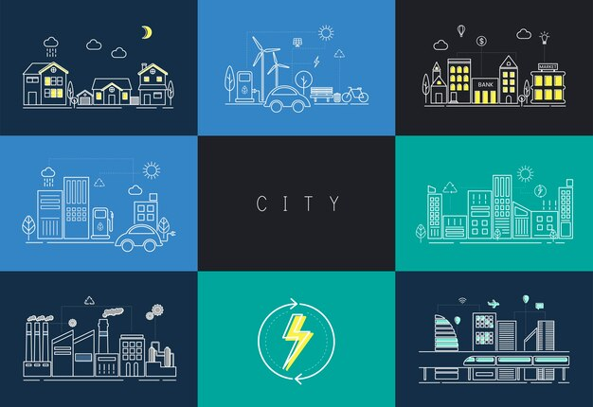
Unit 4 - Energy Management in Cities
Cities can also focus on retrofitting existing buildings with efficient heating technologies. Amsterdam has introduced initiatives to upgrade older residential buildings with modern, energy-efficient boilers and
insulation, reducing energy consumption by up to 40%.
Additionally, promoting the use of heat pumps is gaining traction. In Berlin, many residential and commercial buildings are equipped with air-source and ground-source heat pumps, harnessing ambient heat to provide efficient heating solutions.
Finally, public awareness and community engagement are vital. Cities like Oslo have successfully involved residents in energy-saving programs, educating them on the benefits of sustainable heating practices and encouraging participation in local initiatives. These best practices demonstrate how urban areas can implement sustainable central heating systems that not only meet current energy demands but also contribute to long-term environmental goals.

Slide 36
Unit 4 - Energy Management in Cities
Section 4: Low-energy urban planning: transportation, building and communication for a greener city
Low-energy urban planning is essential for creating greener cities through integrated approaches in transportation, building design, and communication systems. Several European regulatory frameworks and best practices support this transition.
In the European Regulatory Frameworks is possible to find:
1. European Green Deal: this initiative aims to make Europe climate-neutral by 2050, promoting sustainable urban development through various strategies, including energy-efficient buildings and sustainable mobility.
2. Energy Performance of Buildings Directive (EPBD): this directive focuses on improving the energy performance of buildings across the EU, requiring member states to implement energy-saving measures.
3. Sustainable Urban Mobility Plans (SUMPs): The EU
encourages cities to develop SUMPs to promote
sustainable transportation.

Slide 37
Unit 4 - Energy Management in Cities
Best Practices
1. Gothenburg: The city focuses on sustainable transport solutions and energy-efficient buildings, aiming for a significant reduction in carbon emissions.
2. Bologna: Known for its strong emphasis on cycling and public transportation, Bologna is integrating green building practices into urban development.
3. Lisbon: The city promotes sustainable urban mobility through electric public transport and energy-efficient retrofitting of buildings.
4. Stockholm: is recognized for its eco-districts and effective waste management systems, integrating energy efficiency into urban planning.
5. Vienna: emphasises energy-efficient buildings and sustainable transport, with a comprehensive plan to reduce emissions and enhance quality of life.
These references and practices illustrate how low-energy urban planning can lead to sustainable, efficient, and livable cities in Europe.

Slide 38
Unit 4 - Energy Management in Cities
Do’s and don’ts
1. conduct energy audits: regularly assess energy consumption across municipal buildings, public transport and infrastructure.
2. implement renewable energy sources: invest in solar, wind, and other renewable technologies to diversify energy supply.
3. promote energy efficiency: encourage energy-efficient practices in buildings through retrofitting and incentives.
4. develop smart grids: integrate smart grid technologies to improve energy distribution and management.
5. engage the community: involve residents in energy-saving initiatives and education programs.
1. ignore stakeholder input: avoid making decisions without consulting community members and businesses.
2. rely solely on one energy source: don’t depend exclusively on fossil fuels or a single type of renewable energy.
3. overlook regulatory compliance: ensure all energy projects comply with local, regional, and national regulations.

Slide 39
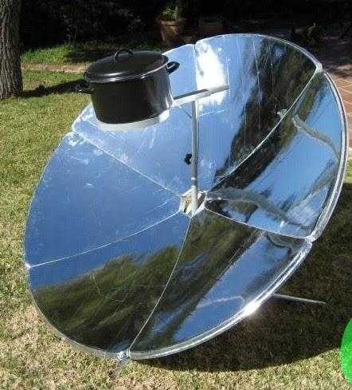
Unit 5 - DIY: how to build a Solar kitchen
Section 1: Introduction to the Solar Oven Solar cooking is gaining increasing attention for its application in various contexts. A solar oven is a device that uses the sun’s energy to cook food without the need for electricity or gas. It’s an eco-friendly and accessible alternative to reduce fossil fuel consumption. In this guide, you will learn how to build one using affordable and easy-to-find materials.
In many remote areas, a solar oven can provide a clean solution to traditional wood-fired cooking, still used by around 3 billion people. Wood use is linked to health problems such as lung disease and deforestation. In remote areas of developing countries, where conventional energy sources (electricity and fuel) are either unavailable or costly, solar ovens offer an alternative to traditional wood-based cooking. According to the IEA (International Energy Agency), approximately 3 billion people worldwide use solid fuels for cooking, primarily firewood, coal, or charcoal. Kerosene or paraffin oil is a cleaner option, as are LPG gases, but they are more expensive and not widely available.

Slide 40
Unit 5 - DIY: how to build a Solar kitchen
Electrification does not cover remote areas. Burning wood or coal indoors leads to air pollution from unburnt hydrocarbons and carbon monoxide, as well as particulate matter. Kitchen smoke is responsible for numerous health issues such as lung cancer, stroke, and ischemic heart disease. Gathering firewood is a risky activity, often undertaken by women and children, and contributes to deforestation. In these contexts, solar cooking offers a valuable alternative, improving the quality of life in remote communities. Additionally, in countries with widespread energy access, solar ovens can also be used for recreational and educational purposes, such as in campsites or parks, and they play an important role in promoting sustainability.
In industrialised nations, conventional energy sources such as natural gas, oil, or electricity are commonly used for cooking, and the associated energy consumption accounts for approximately 10% of the total household energy usage. While occasional solar cooking may lead to modest energy savings, it offers other benefits, especially educational and social.

Slide 41
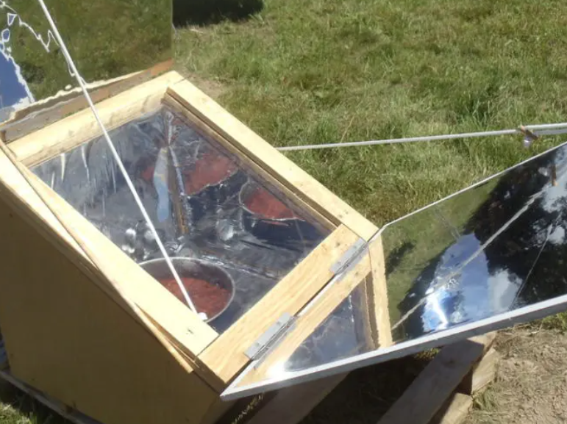
Unit 5 - DIY: how to build a Solar kitchen
Solar cooking could spread as a recreational and social activity, for example, in campsites, parks, gardens, or beaches. The primary advantage is that it produces no smoke and poses no fire risk, which is why other cooking methods (barbecues, gas) are often banned in public spaces. Solar cooking has significant educational value. First, it helps spread the culture of sustainability and understanding the potential (and limitations) of solar energy. Second, it fosters social interactions and community building. Finally, mastering solar cooking raises awareness of energy consumption in cooking and promotes energy savings even with conventional kitchen methods. Various solar cooking techniques have been experimented with by researchers and creators, resulting in different devices with varying levels of complexity, size, performance, and cost. The most commonly used types include box ovens, concentrator ovens, and intermediate models like panel cookers. The box-type solar oven offers the advantage of being easy to build using common, low-cost materials. The receiver (where the food is placed) is located inside a thermally insulated box, whose top is covered by transparent glass. These ovens have low power, reaching a maximum of 100°C. Adding external mirrors increases the capture area, potentially reaching up to 200°C.

Slide 42
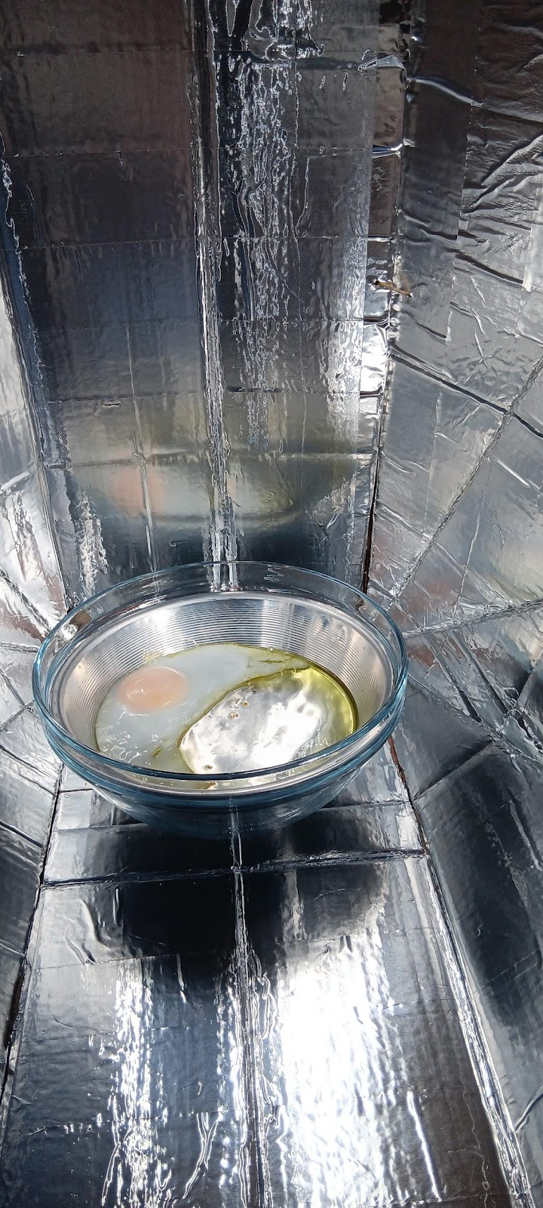
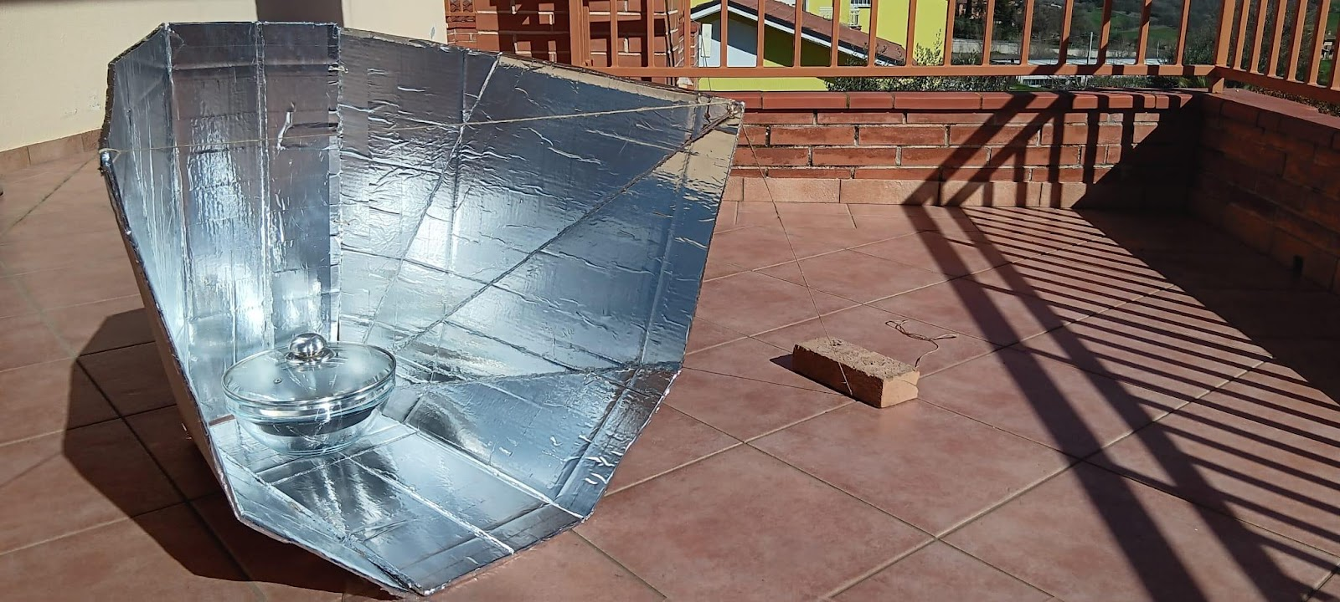
Unit 5 - DIY: how to build a Solar kitchen
The most common concentrator cookers use a parabolic reflector that reflects and concentrates sunlight onto the focal point where the receiver is located. They are usually 1-2 metres in diameter and can provide enough power to cook in various ways (boiling, frying, sautéing). While portable, they are generally not foldable. Non-parabolic concentrator ovens also exist, using the same principle to increase cooking power and temperature. Among these are various designs with tube receivers. Some large ovens are used for collective cooking (from 10 to 50 meals), and there are examples of solar catering.

Slide 43
Unit 5 - DIY: how to build a Solar kitchen
Building a Solar Oven: Necessary Materials
There are several types of solar ovens: box ovens (like the one we are building), concentrator cookers, and panel cookers. This box oven is one of the simplest options to make and use, making it ideal for DIY construction.
To build your solar oven, you will need:
A cardboard box (one large and one smaller that can fit inside the first)
Aluminium foil (to reflect sunlight)
Plastic wrap or glass (to cover the top and trap heat inside)
Tape or glue
Markers or paints to personalise the oven
Black paper or dark cardboard (to absorb heat)
A thermometer (optional, to measure the internal temperature)

Slide 44
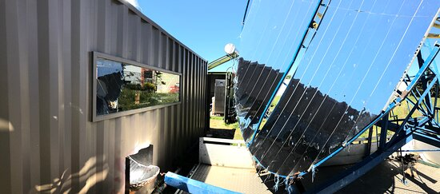
Unit 5 - DIY: how to build a Solar kitchen
Construction Steps The oven designed by Prof. Celestino Ruivo (Portugal) is built from two cardboard panels covered with
reflective material, with appropriate cuts and folds. The pot or a double black-coloured metal container is covered with a glass casing.
Box Preparation: Take the larger cardboard box and line the inside with aluminium foil. This will reflect sunlight towards the inside of the oven, increasing heat. Secure the foil with tape.
Transparent Cover: Cut an opening in the box’s lid, leaving about a 5 cm border. Cover the opening with plastic wrap or a piece of glass. This step allows sunlight to enter the oven while trapping the heat inside.
Placing the Second Box: Insert the smaller box inside the larger one. Line this box with aluminium foil as well, so that sunlight is reflected towards the food. At the bottom of the smaller box, place black paper or dark cardboard to absorb heat.
Correct Angle: Place the oven in an area where it will receive the most direct sunlight possible. You can tilt it using makeshift supports to get the optimal angle towards the sun.

Slide 45
Unit 5 - DIY: how to build a Solar kitchen
Section 4: How to Use a Solar Oven
Building a solar oven is a simple project that lets you discover solar energy in a practical way. Not only will you save resources, but you’ll also help reduce your family’s environmental impact. Put what you’ve learned into practice and engage your community in promoting sustainable solutions.
Choose Suitable Foods: Solar ovens are perfect for slow-cooking dishes like rice, vegetables, bread, or cookies.
Cooking Times: The cooking time will depend on the intensity of sunlight. The more sun there is, the faster the oven will heat up.
Measure the Temperature: If you have a thermometer, you can monitor the oven’s internal temperature. A good solar oven usually reaches between 70°C and 120°C.
Section 5: Advantages of a Solar Oven
Sustainable: It doesn’t require fossil fuels, reducing environmental impact.
Cost-Effective: You can build it with recycled materials and don’t need electricity or gas.
Easy to Build and Use: You can involve the whole family in the project

Slide 46
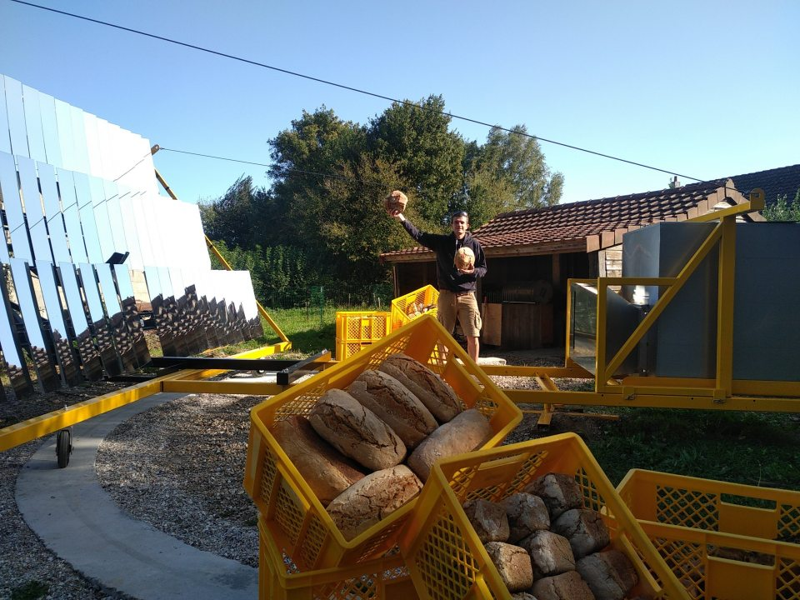
Unit 5 - DIY: how to build a Solar kitchen
Section 6: Practical Tips and Maintenance
Cleaning: Keep the glass or plastic wrap clean to ensure the oven’s maximum efficiency.
Repairs: If the foil gets damaged, replace it to maintain the reflective effect.
Storage: Store the oven in a dry place when not in use to avoid moisture damage.
Storage: Store the oven in a dry place when not in use to avoid moisture damage.

Slide 47
Summing up
DIY
Save Energy
Many solutions can also be very challenging from an economic point of view. This is why one can learn to find inexpensive and replicable solutions without large budgets
The best way to reduce environmental impact is to consume less. And this can be done both by changing the way we live and by adopting sustainable technological solutions
Education
Technology is certainly a great help in tackling the reduction of consumption. But technology without awareness of the problems we are facing, and subsequent training on these topics, will not bring the desired results. Let us start with education
Community
Everyone's change has an impact. But doing it as a community allows us to do much more. Creating shared solutions generates very important results

Slide 48
Thank you!
Partner: Gramigna APS

